Slide 1
KnowThings
Hackathon No. 2

Slide 2
Your Mission
Connect LIDAR to a Raspberry Pi
Report its data to an OM2M server
Virtualize it

Slide 3
SETUP: SD Card Network Settings
Add wpa_supplicant.conf to the boot partition.
Use “KnowThings_717E” or “KnowThings_1CB2” or “knowthingsblue”
update_config=1
network={
ssid=“KnowThings_717E” (or KnowThings_1CB2)
psk=“knowthings”
scan_ssid=1
}

Slide 4
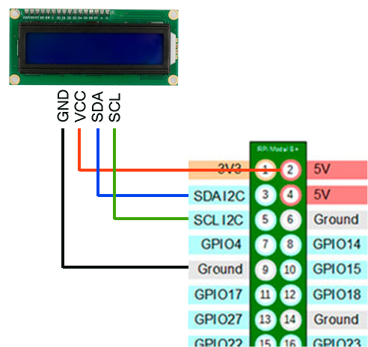
SETUP: KS1602 I2C LCD Display
Vcc to RPi pin 2 (5VDC)
GND to RPi pin 9
SDA (I2C Data) to RPi pin 3
SCL (I2C Clock) to RPi pin 5

Slide 5
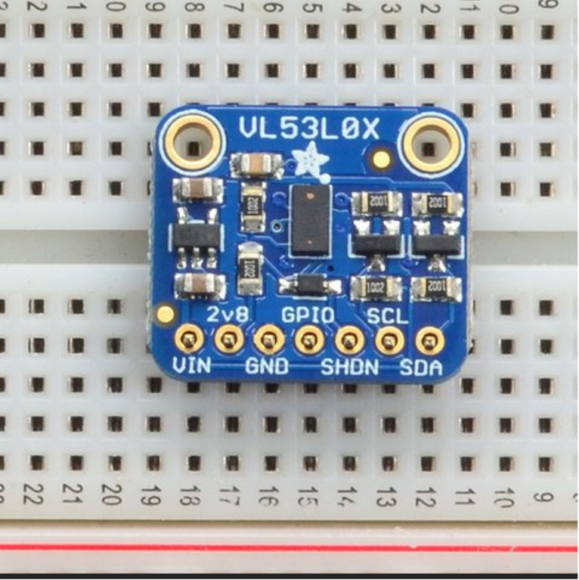
VL53L0X Time of Flight ranging sensor
VIN: 3-5VDC in
2v8: 2.8VDC@100ma supply
GND
GPIO: data-ready
SHDN: shutdown (3-5V ok)
SCL: I2C Clock
SDA: I2C Data
https://learn.adafruit.com/adafruit-vl53l0x-micro-lidar-distance-sensor-breakout

Slide 6
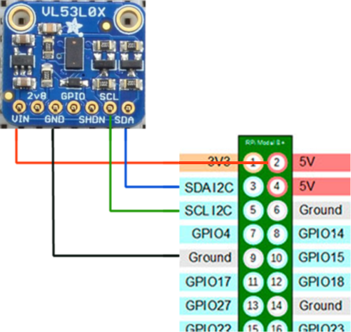
Connect to the RPi
VIN to RPi pin 2 (or 1)
GND to RPi pin 9 (or 6)
SCL to RPi pin 5
SDA to RPi pin 3
https://github.com/johnbryanmoore
/VL53L0X_rasp_python

Slide 7
Read the Sensor (sample code)
$ ssh pi@192.168.xxx.xxx
pi@192.168.xxx.xxx's password: raspberry
$ cd sens/vl53l0x/
$ ls
core_vl53l0x.py loop_vl53l0x.py

Slide 8
Downloading the OM2M Server
Install Java 8 (Java 10 doesn’t work) http://www.oracle.com/technetwork/java/javase/downloads
=> used JDK-8U171
Download OM2M server from http://wiki.eclipse.org/OM2M/Download
Unzip the download someplace like /hackathon/om2mserver
Download the OM2M monitor jar: https://www.laas.fr/projects/IOT/sites/www.laas.fr.projects.IOT/files/u77/monitor.jar

Slide 9
Starting the OM2M Server and Gateway
Go to /in-cse and execute start.bat or start.sh
Go to /mn-cse and execute start.bar or start.sh
Launch the Monitor: java –jar monitor.jar
localhost:8080/webpage (admin/admin)
REST API: http://wiki.eclipse.org/OM2M/one/REST_API
Parent URL: http://wiki.eclipse.org/OM2M/one

Slide 10
Register Your Sensor
POST http://localhost:8080/~/in-cse
X-M2M-Origin: admin:admin Content-Type: application/json;ty=2
{
"m2m:ae":
{
"api": "app-sensor",
"rr": "false",
"lbl": ["Type/sensor", "Category/distance", "Location/hackathon"],
"rn": “VL53L0X"
}
}

Slide 11
Sending Data
Create a Data Container
Then log data
Optionally, the Monitor can listen for data events

Slide 12
Extra Credit: Virtualize
https://knowthings.io/eap
Early Adopter download (yeah, there’s a registration step)
Documentation: https://knowthings.gitbook.io/ktug/v/0.3.0/
Process:
Capture packets
Create virtual device
“Play back” device
Result: OM2M server should act as if real sensor data were being transmitted

Slide 13
Contact
Thank you for participating!
I’m Rob.
Robert.Eaglestone@ca.com
birdrock@knowthings.io

Slide 14
Appendix: OM2M get sensor list
Get a list of registered sensors.
GET http://localhost:8080/~/in-cse?fu=1&lbl=Type/sensor
X-M2M-Origin: admin:admin Accept: application/json
(no content)

Slide 15
Appendix: OM2M create data container
POST http://localhost:8080/~/in-cse/in-name/VL53L0X
X-M2M-Origin: admin:admin
Content-Type: application/json;ty=3
{
"m2m:cnt":
{
"rn": “MY_DATA"
}
}

Slide 16
Appendix: OM2M log data
POST http://localhost:8080/~/in-cse/in-name/VL53L0X/MY_DATA
X-M2M-Origin: admin:admin
Content-Type: application/json;ty=4
{
"m2m:cin":
{
"rn": “my_data_instance_1“,
“cnf”: “application/json”,
“con”: “{\”distance\”:214,\”timestamp\”:1517912099}”
}
}

Slide 17
Appendix: Subscribe to OM2M container
POST http://localhost:8080/~/in-cse/in-name/VL53L0X/MY_DATA
X-M2M-Origin: admin:admin
Content-Type: application/json;ty=23
{ "m2m:sub": {
"rn": "subscribe_test",
"nu": ["http://localhost:1400/monitor"],
"nct": 2,
"enc": {
"net": 3
}}}

Slide 18
Appendix: OM2M data retrieval
GET http://localhost:8080/~/in-cse/in-name/VL53L0X/MY_DATA/my_data_instance_1
X-M2M-Origin: admin:admin
Accept: application/json
(no content)

